Slide 1
Bank CRM Analysis Power Bi Project By Rachana.S

Slide 2
Agenda
Introduction
Problem Statement
Data Overview
Metrics and their Insights
Dashboard
Conclusion.

Slide 3
Introduction
CRM Analysis: Customer Relationship Management analysis is the process of using customer data to understand behavior , improve relationships and drive business growth.
Why?
Understand Customers Better – track preferences, behavior, and needs.
Increase Customer Retention – identify customers at risk of churn.
Boost Sales – upsell & cross-sell opportunities.
Personalized Marketing – segment customers for targeted campaigns.
Better Decision-Making – data-driven insights, not guesswork.

Slide 4

Problem Statement
Objective:
To analyze customer demographics , transactions and churn patter using Power Bi and identify key factors influencing customer churn and dissatisfaction .
The bank aims to reduce customer churn, improve service delivery, and enhance customer satisfaction.

Slide 5
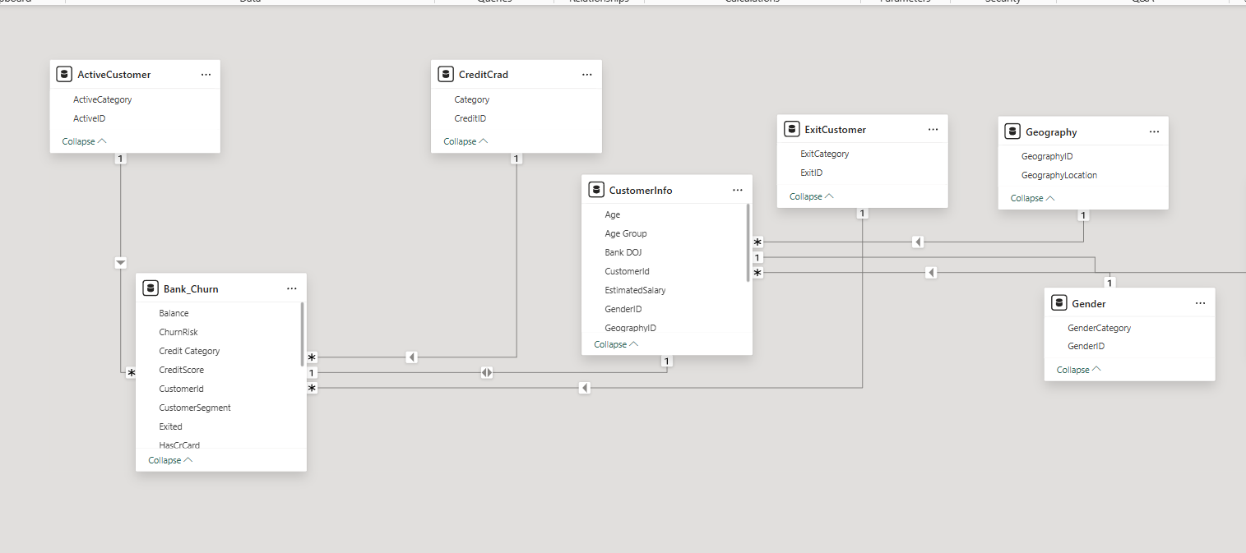
Data Overview

Slide 6
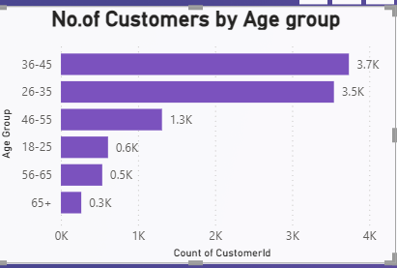
Metric 1 : Customer Count By Age - Group
Insights:
26-45 age group forms the majority of customers
46-55 is a mid-sized segment.
65+ is the smallest , showing low senior penetration.
Recommendations:
Focus retention on 26-45 group.
Offer retirement planning for 46-55.
Expand senior-friendly services for 65+.
Effective body language enhances your message, making it more impactful and memorable:
Meaningful eye contact
Purposeful gestures
Maintain good posture
Control your expressions

Slide 7
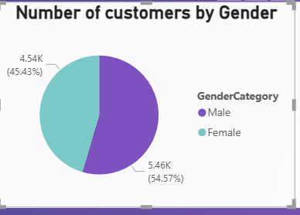
Metric 2 : Number of Customers by Gender
Insights:
The majority of customers are male (54.57%), while females make up 45.43%.
Slight gender imbalance allows churn behavior comparison.
Recommendations:
Use Gender-based analysis to tailor engagement and retention strategies

Slide 8
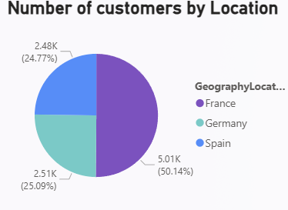
Metric 3 : Country Wise Customers
Insights:
France has the largest customer base with 50.14% (5.01K customers).
Germany and Spain contribute 25.09% and 24.77%, respectively.
This geographic spread helps in identifying region-wise churn and engagement trends

Slide 9
Metric 4: Gender wise Avg Income in each region
Insights:
Germany: Females has the highest average income.
France : Males earn slightly more than females.
Spain: Lowest male income , with widest gender gap.
Recommendations:
Target High-income females in Germany and Spain with premium products.

Slide 10
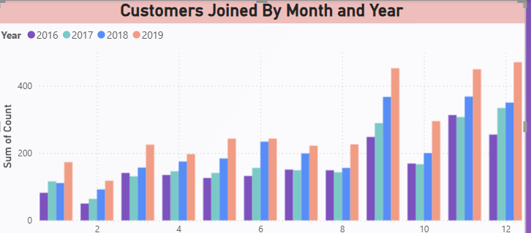
Metric 5: Customers Joining By month and Year
Insights:
Acquisition rose year by year.
Peak Joins: Sep –Dec (Highest in Dec).
Low Joins : Jan – Mar.
2019 showed strongest growth.
Recommendations:
Analyze 2019 strategies and replicate successs.

Slide 11
Metric 6: Churn count By Region
Insights:
France : Largest Customer Base.
Germany : Smaller base, highest churn.
Spain : Moderate churn.
Recommendations:
Address churn in Germany with retention programs and local offers.
Monitor churn trends in France and Spain.

Slide 12
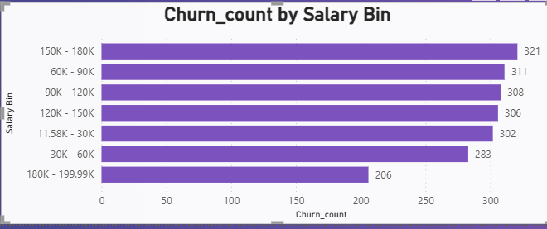
Metric 7: Churn count By Salary Bin
Insights:
Highest churn : High income followed closely by 100-150K.
Mid-income : Moderate churn.
Lowest churn : < 50k group.
Recommendations:
Retain high income customers with premium services and wealth management.
Safeguard mid-income with competitive offerings..

Slide 13
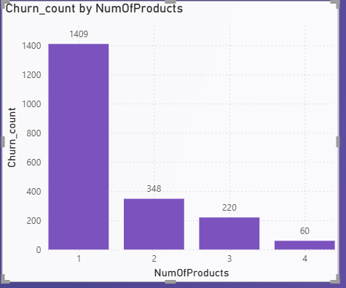
Metric 8: Churn count By Number of Products
Insights:
High risk : 3-4 products (most unstable, high churn).
Moderate risk : 1 product.
Low risk : 2 products (more loyal).
Recommendations:
Address churn in 3-4 product customers via surveys and complaint analysis.
Protect 2-product segment as the most stable group.

Slide 14
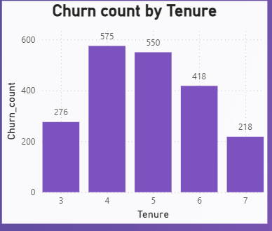
Metric 9: Churn count By Tenure
Insights:
Churn peaks at 4-5 years ( mid-term risk).
Lowest churn after 7 years (High Loyalty).
Early tenure churn lower than mid-term.
Recommendations:
Engage customers at 3-4 years to prevent midterm attrition.
Reward Loyalty beyond 5 years.
Collect feedback at year 4 to address churn drivers.

Slide 15
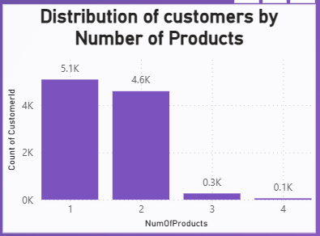
Metric 10: Distribution of Customers by Number of Products
Insights:
Majority holds only 1 or 2 products, with 5.1K and 4.6K customers respectively.
Very few with 3+products, indicating low product penetration.
This presents a cross-selling opportunity to boost multi-product adoption.

Slide 16
Metric 11: Churned Customers By Credit Scores
Insights:
Highest churn : 600-699 scores.
Significant churn : 300-499 (Financial instability).
Lowest churn : 800-900(loyal, stable).
Recommendations:
Focus retention efforts on mid-credit score customers (600-699) , offer better service to reduce churn.

Slide 17
Metric 12: Credit Card Holders By Age-Group
Insights:
Largest cardholders : 46-55
Strong adoption : 18-25
Lowest holding : 65+
Recommendations:
Target 46-55 age group with premium cards and loyalty programs.
Engage 18-25 with student/entry level card for long term loyalty.

Slide 18
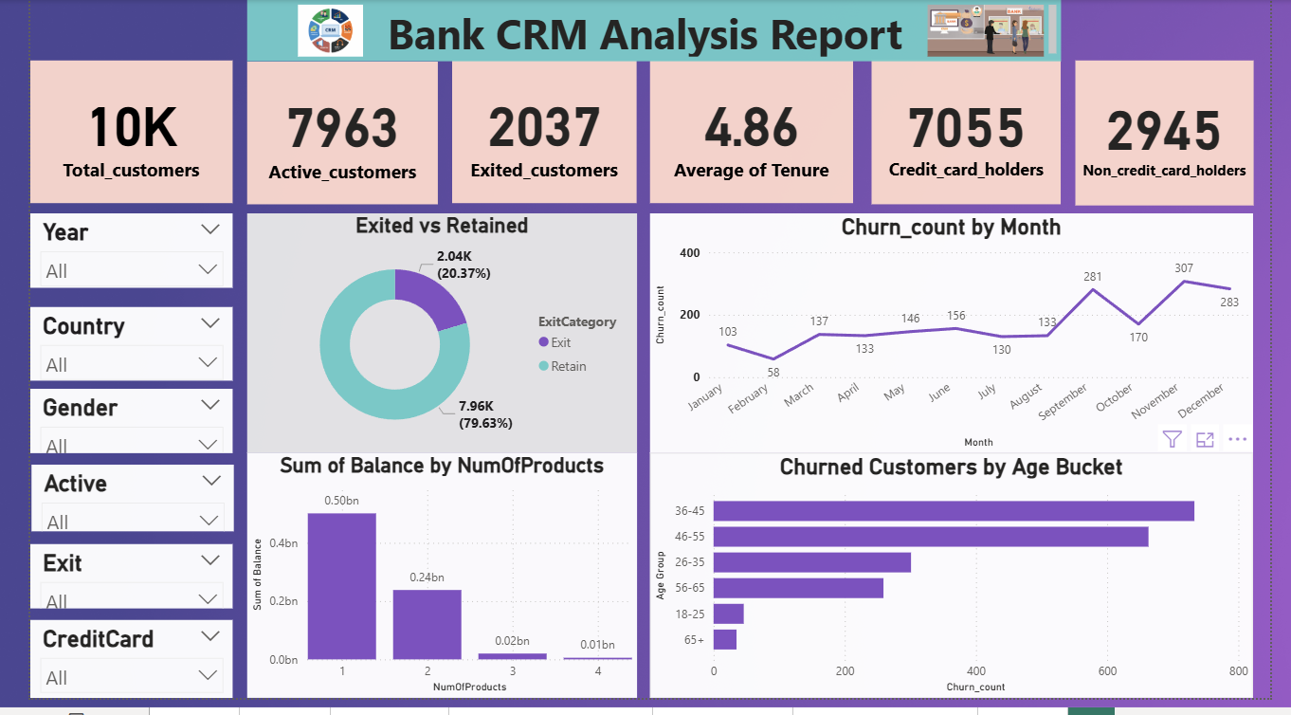

Slide 19
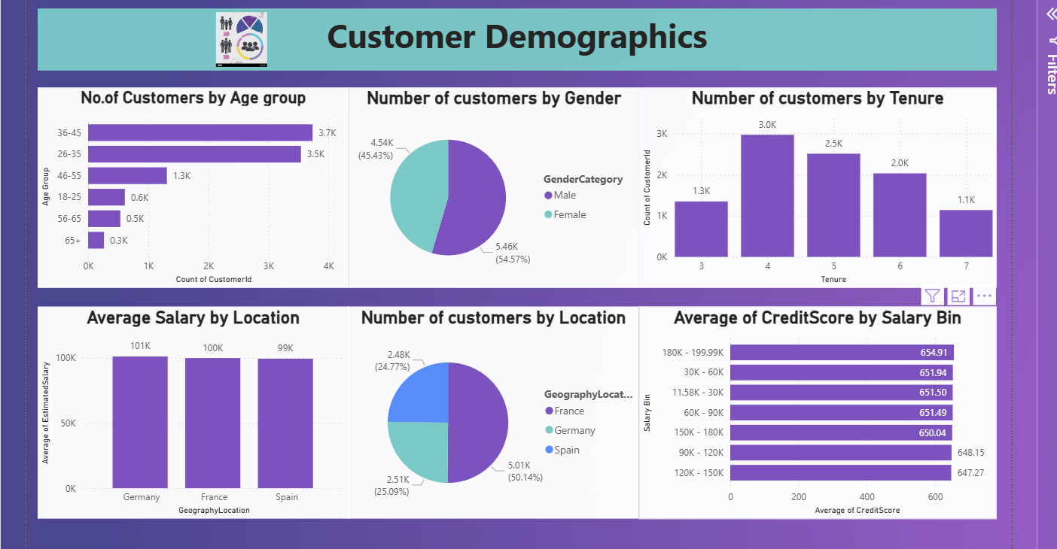

Slide 20
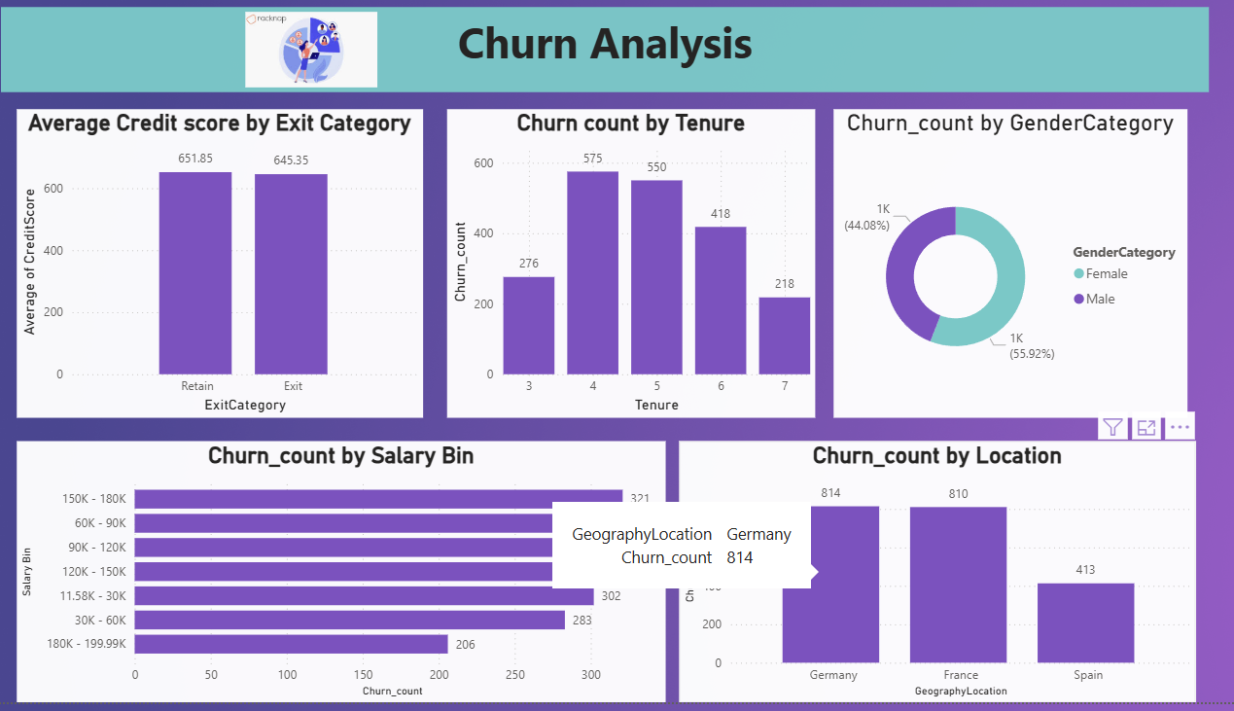

Slide 21
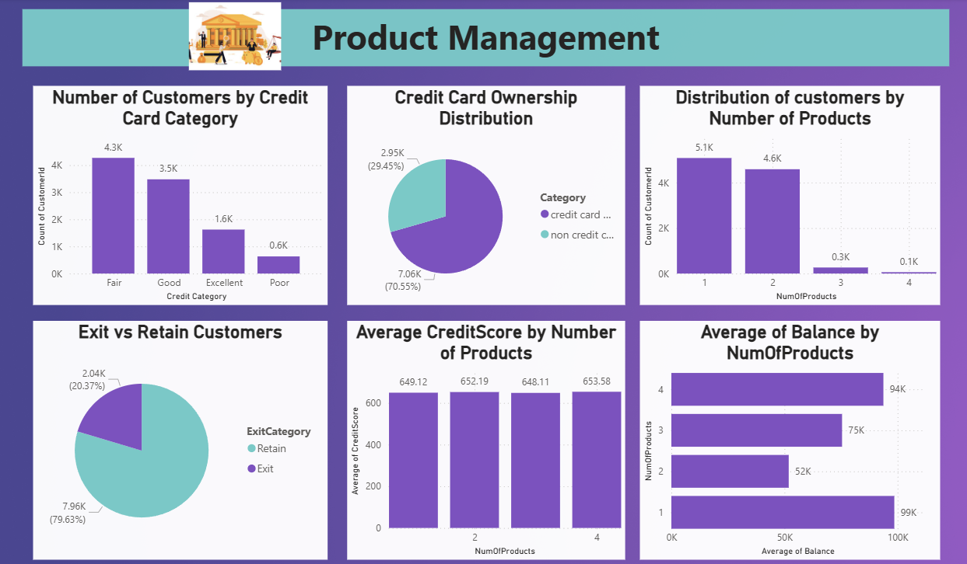

Slide 22
Tracks overall churn (active vs. exited).
Highlights at-risk segments by gender, age, and tenure.
Shows seasonal churn trends (monthly view).
Analyzes product engagement via credit card ownership.
Offers filters by country & year for region-specific insights.
Conclusion

Slide 23
Thank you

